Slide 1
TwinCAT Introduction Hands on Session
Anders Sandström
Electronics Engineer
www.europeanspallationsource.se
14 November 2016

Slide 2
Outline
TwinCAT overview
Runtime
Engineering Tool
License system
Data Links
Control Loops (Motion)
Configuration
FB_DriveVirtual
Hands on session

Slide 3
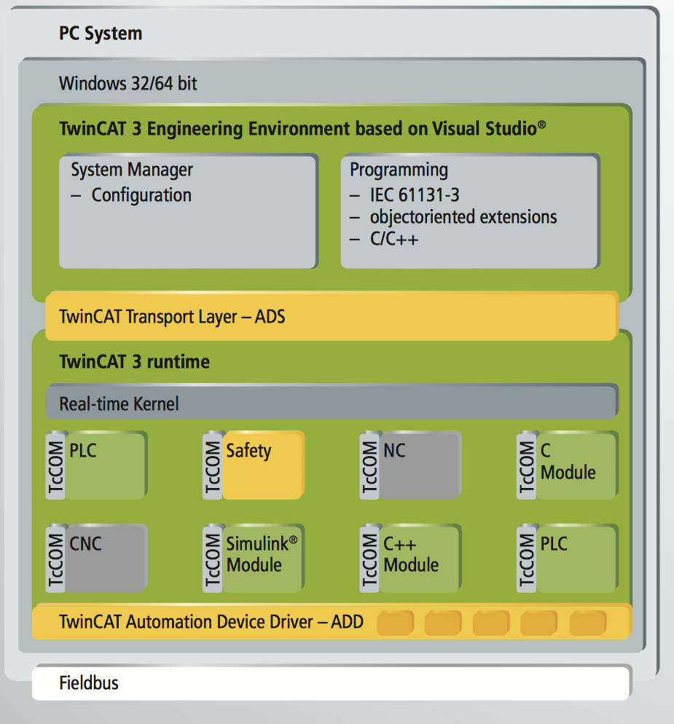
TwinCAT Overview
TwinCAT:
“Soft PLC” system
Runs on/under Windows systems
Two generations available:
TwinCAT 2.x
TwinCAT 3.x
Notes:
https://download.beckhoff.com/download/document/catalog/Beckhoff_TwinCAT3_042012_e.pdf

Slide 4
TwinCAT 3.1 XAR (Runtime)
XAR : eXtended Automation Runtime
Real time environment
PLC
Motion
..
Notes:
https://download.beckhoff.com/download/document/catalog/Beckhoff_TwinCAT3_042012_e.pdf

Slide 5
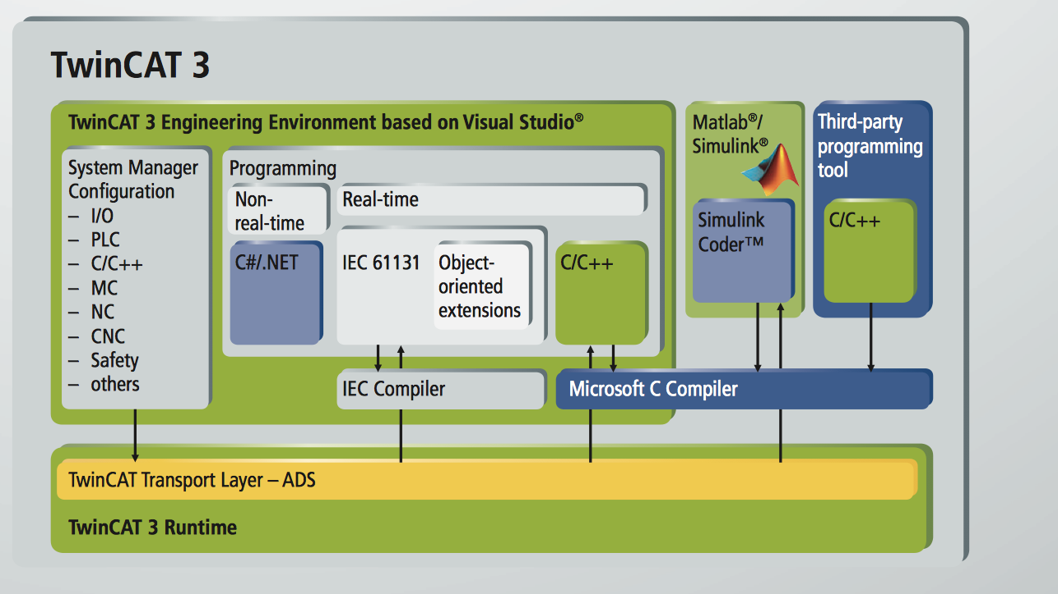
TwinCAT 3.1 XAE (Engineering tool)
XAE : eXtended Automation Engineering:
Integrated into Visual Studio®
support for the native Visual Studio® interfaces (e.g. connection to source code management systems)
IEC 61131-3 languages (with object oriented extensions), Structured Text (ST), Function Block Diagram (FBD)
C++ support (with debugger)
Integration with Matlab Simulink possible (Matlab Simulink coder)
Possibility for .NET projects in the same solution (e.g. for HMI)
Safety editor
Motion libraries (PLC-Open compliant)
…
Notes:
https://download.beckhoff.com/download/document/catalog/Beckhoff_TwinCAT3_042012_e.pdf

Slide 6
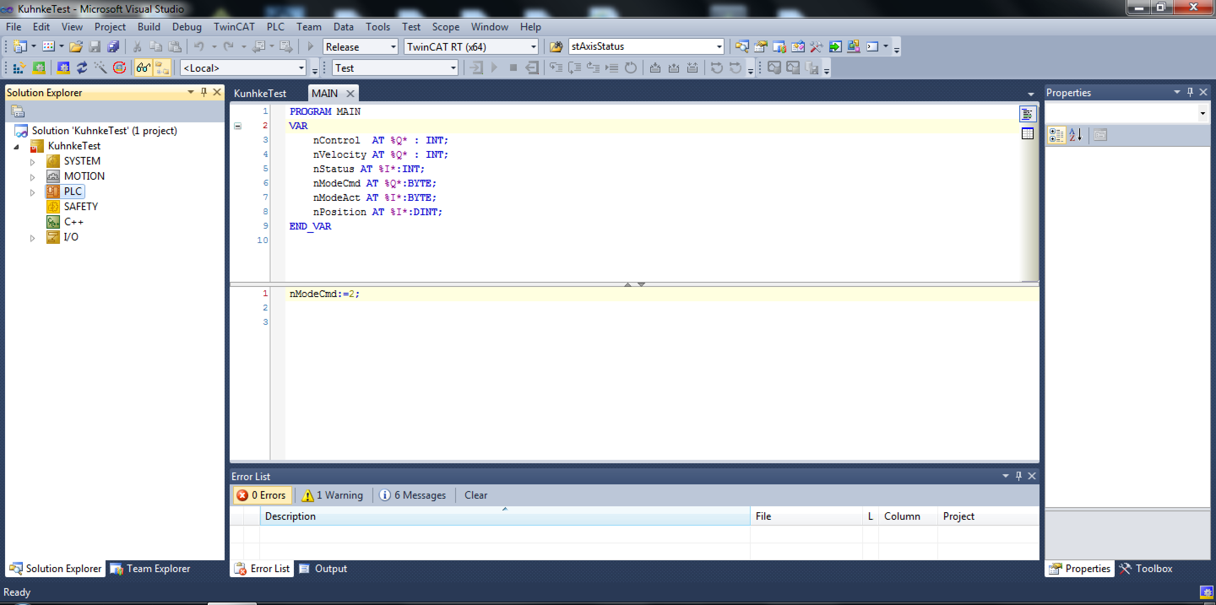
Engineering Tool: Overview
Notes:
Explain different windows

Slide 7
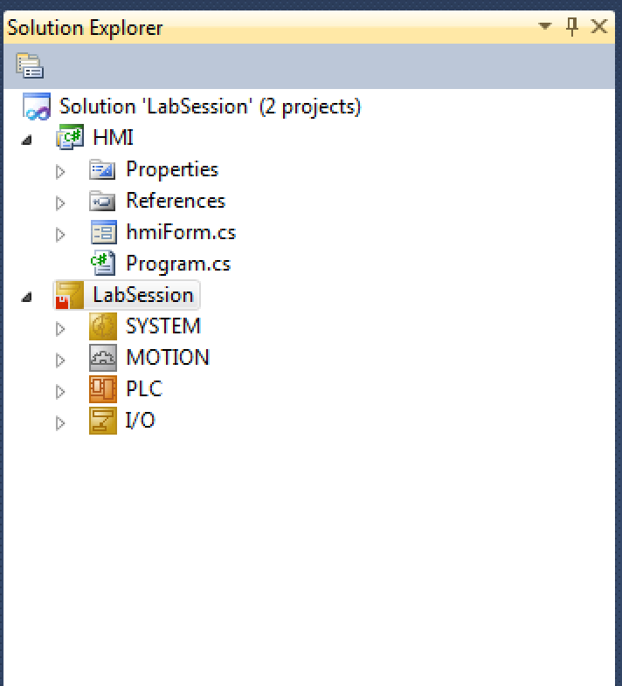
Software “management”
Highest level in solution explorer tree is “Solution”
A solution can contain several projects.
Project types:
C# (non realtime)
TwinCAT (realtime)
C++
..
A TwinCAT Project can contain source code and configurations (hardware and other)

Slide 8
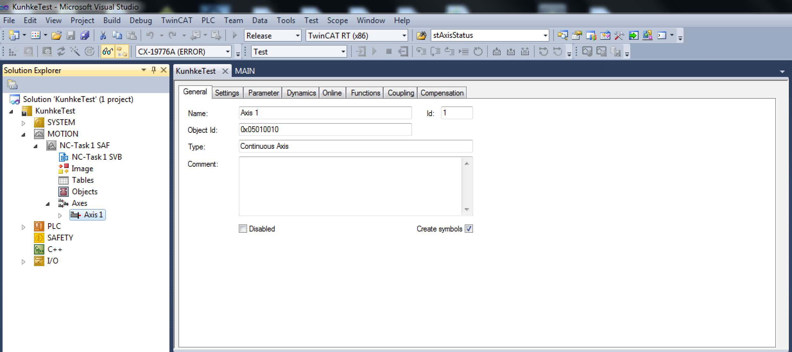
Motion

Slide 9
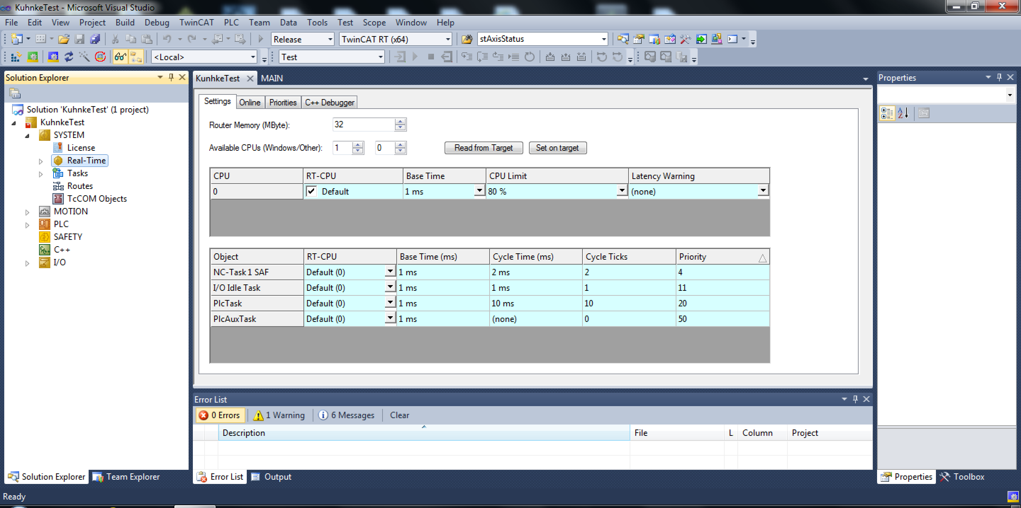
System

Slide 10
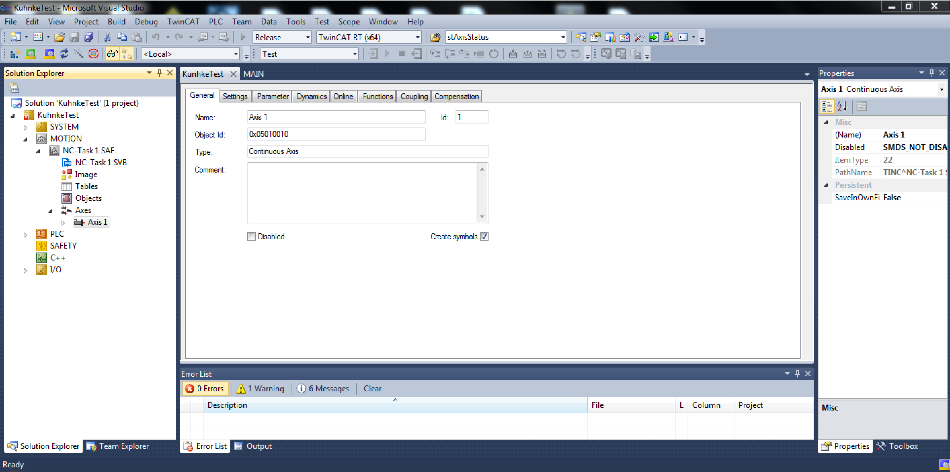
Motion

Slide 11
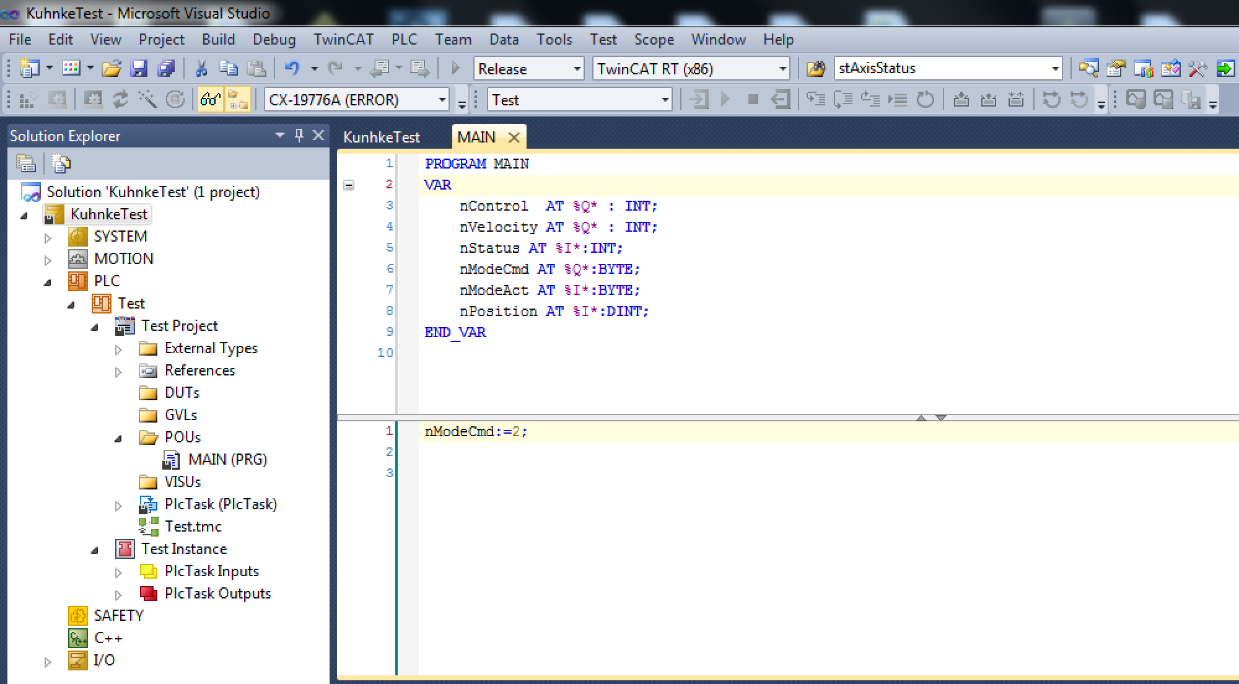
PLC

Slide 12
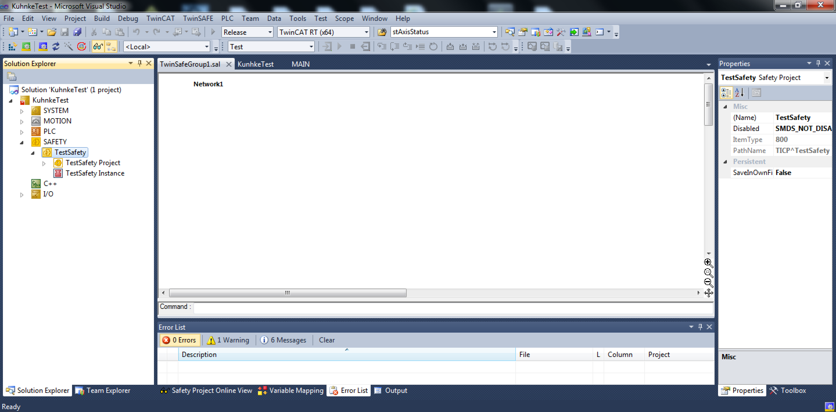
Safety

Slide 13
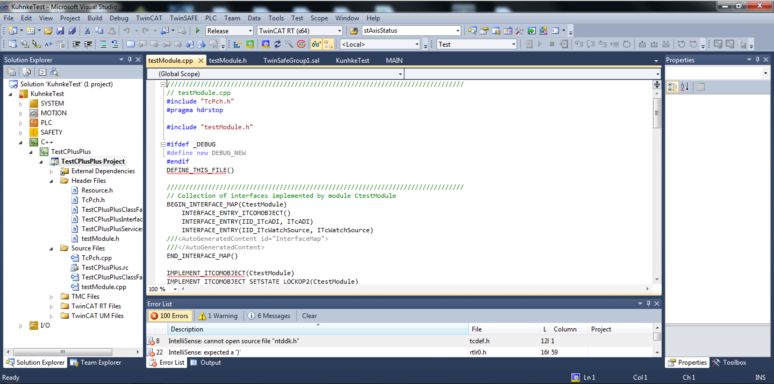
C++

Slide 14
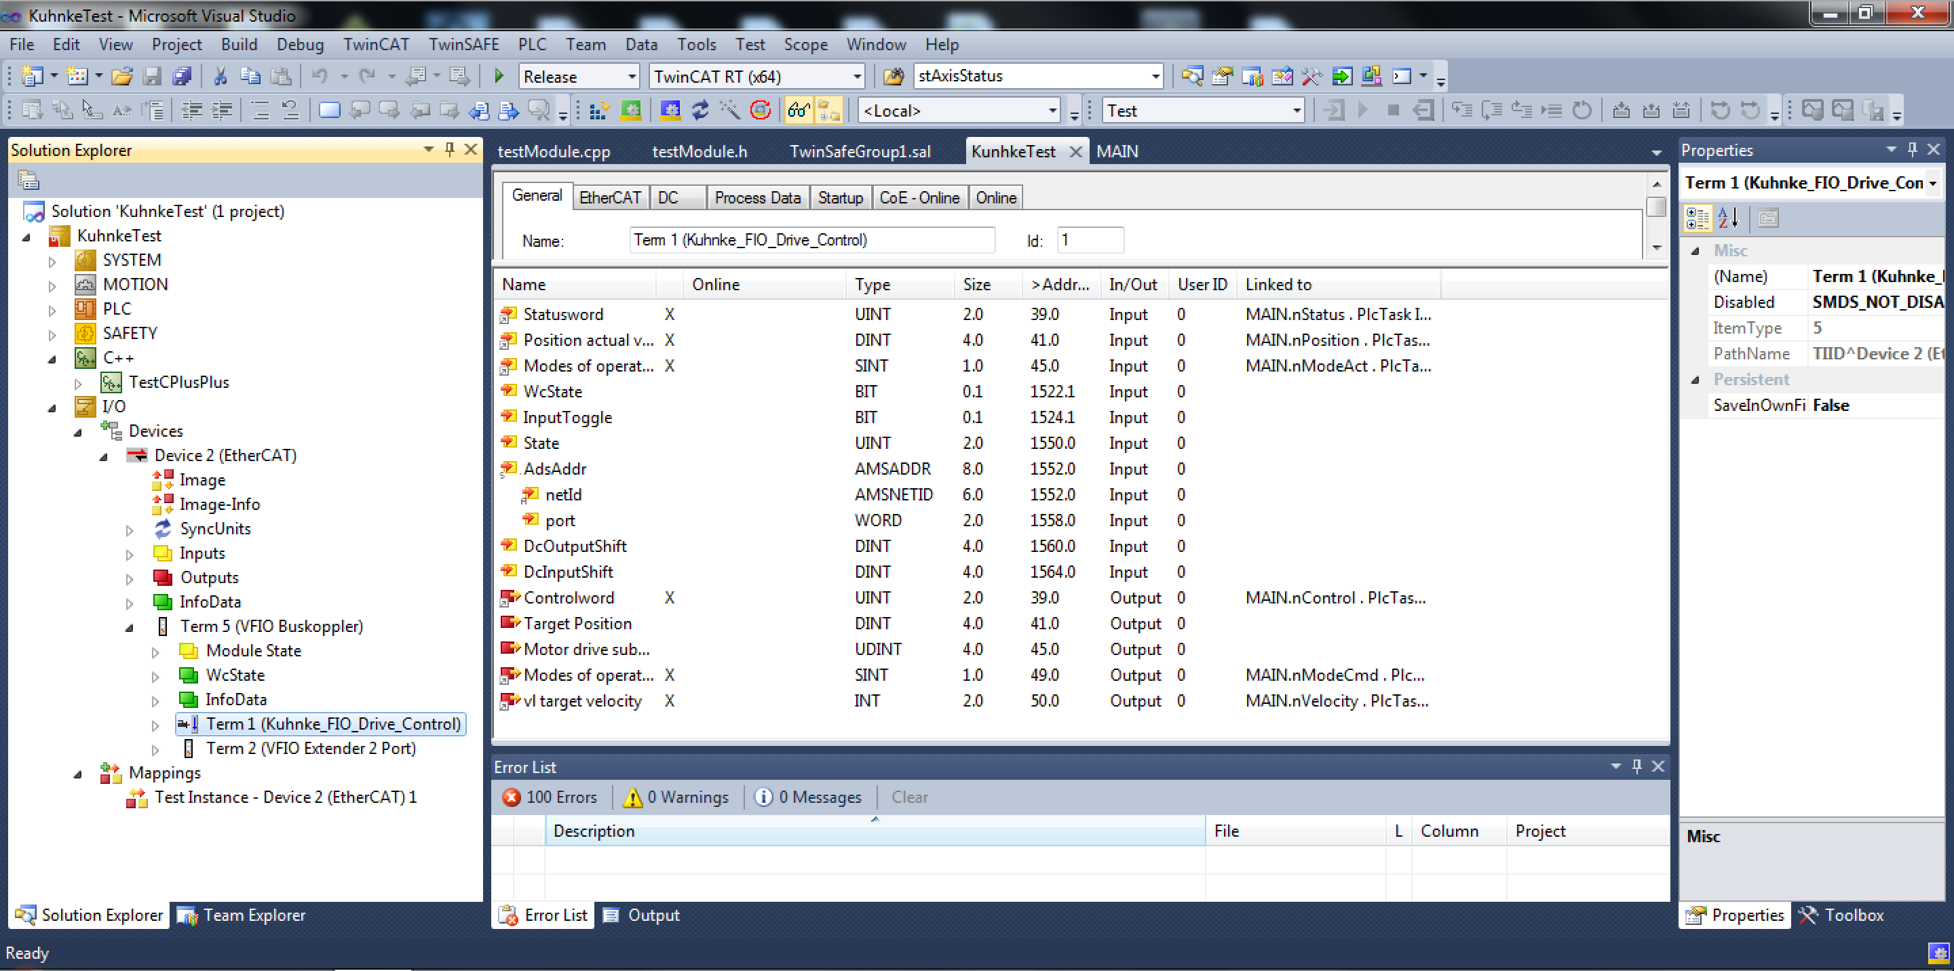
I/O

Slide 15
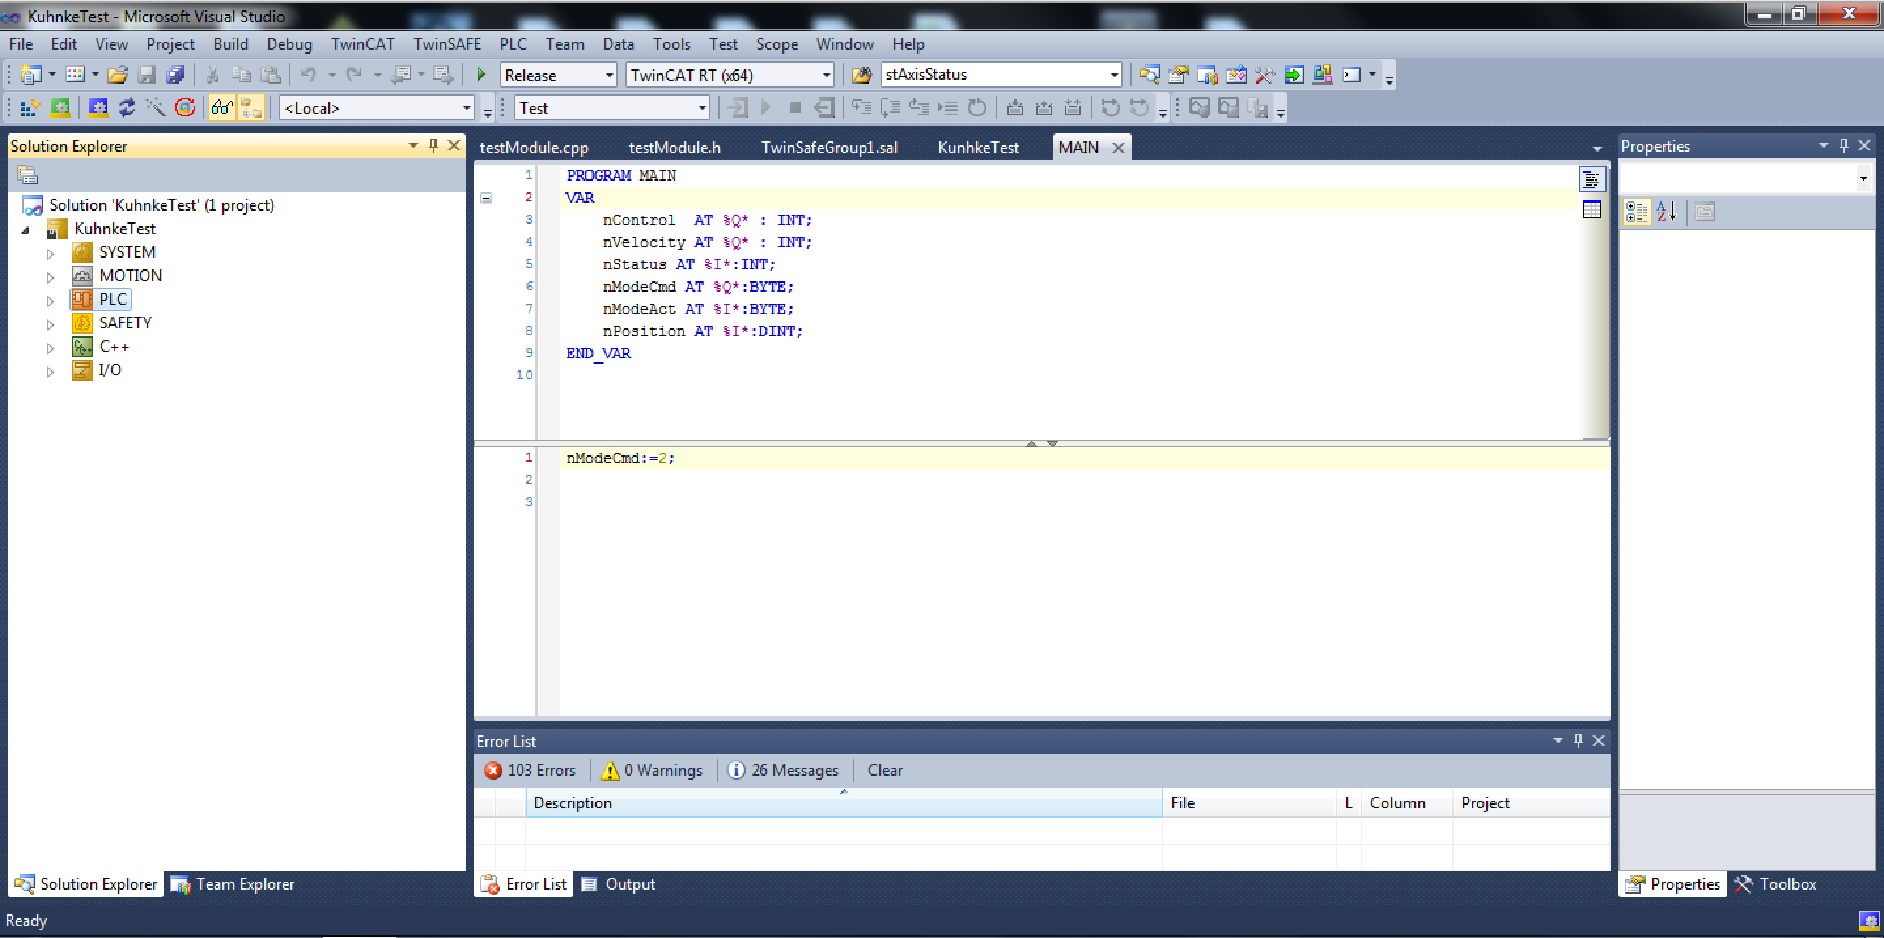
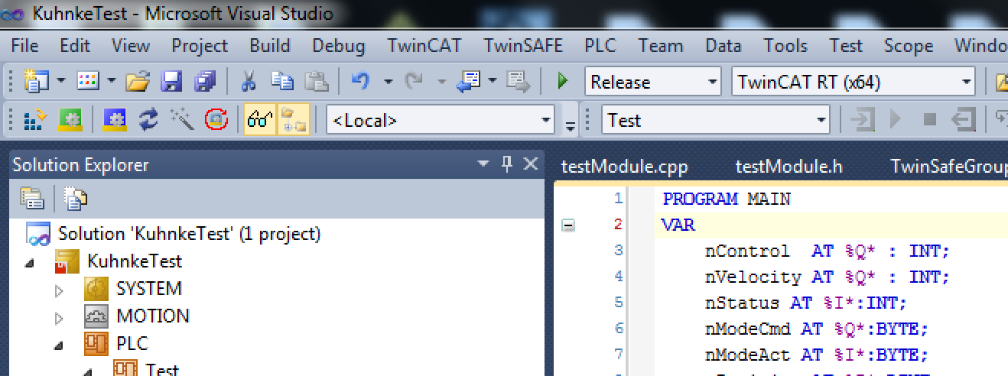
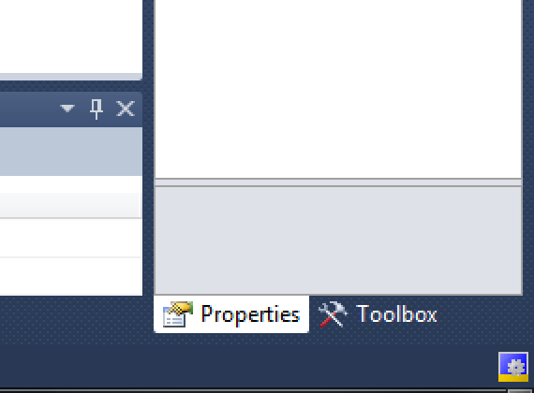
Application Control/Status

Slide 16
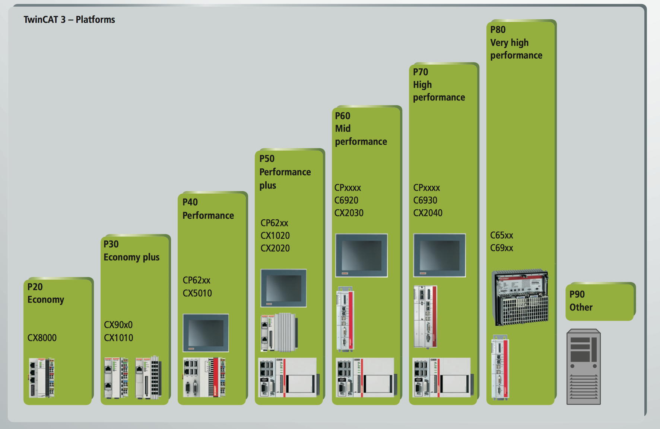
License System
Engineering tool is free
Runtime licenses are needed.
Runtime licenses are needed for functionalities:
PLC
Motion
HMI
Connectivity
C++
…
License costs are related to performance of CPU (performance classes)
1 week trial licenses can be generated (unlimited number of times).
Example:
Our test crate needs licenses for approx. 700Eur (including Windows license and 8 axes)
Notes:
Licenses also need a lot of administartion…
Trial licence convieneient since you can test evetything and then se which licences you need.
https://download.beckhoff.com/download/document/catalog/Beckhoff_TwinCAT3_042012_e.pdf

Slide 17
Data Links
Data exchange between different modules are done through “data links”
Example:
Digital inputs, or other I/O, can be linked to a PLC variable
A motion axis can be linked to an amplifier, encoder and PLC program.
Pros:
Nice way to separate hardware from software
Cons:
Can be a lot of work to link variables
Easy to make mistakes (link wrong variables)

Slide 18
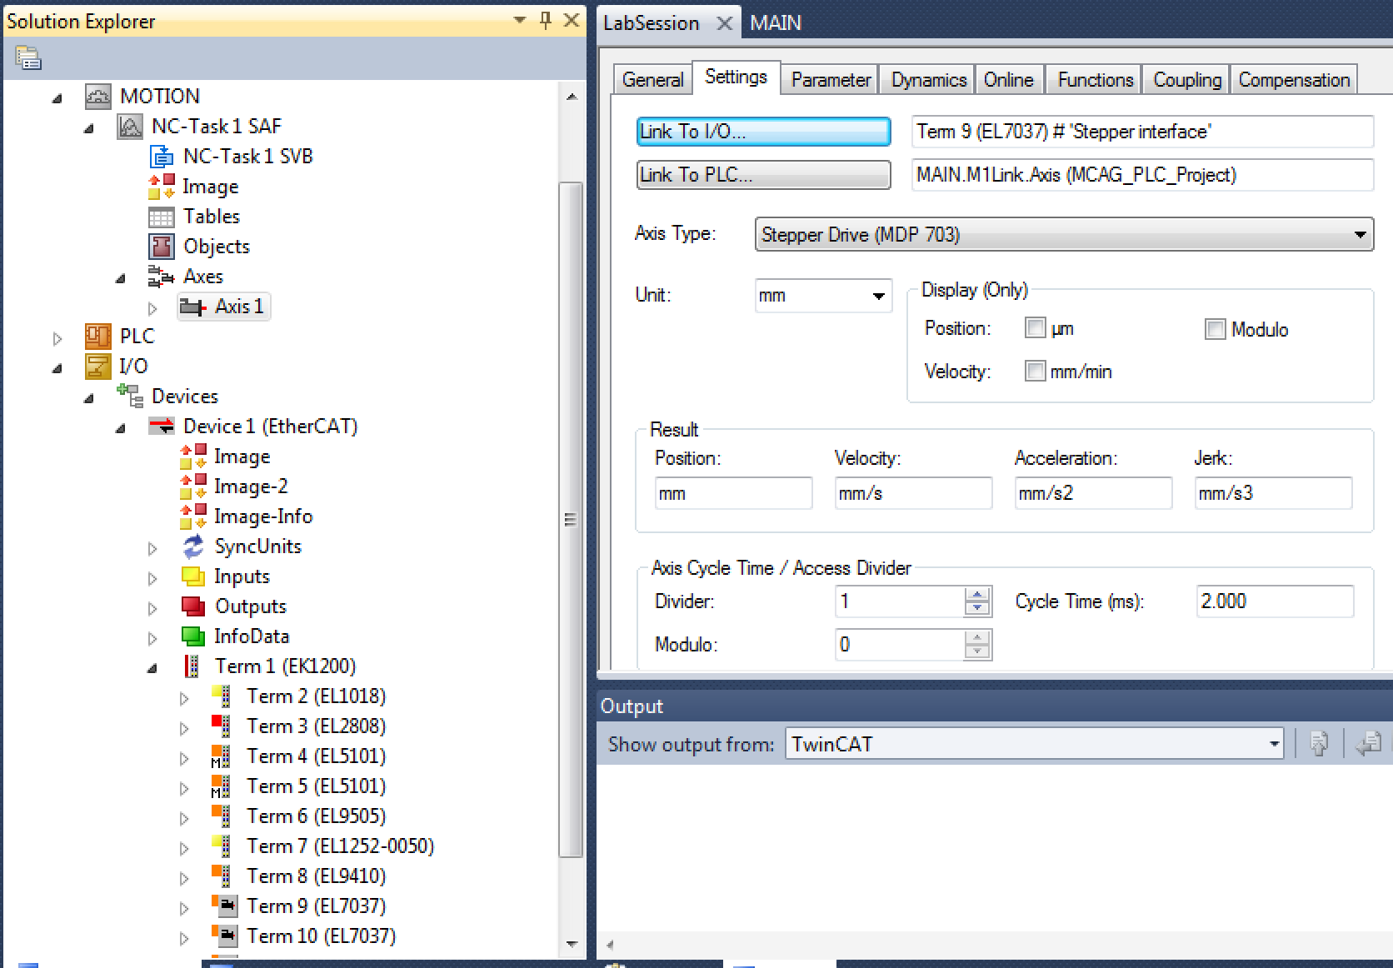
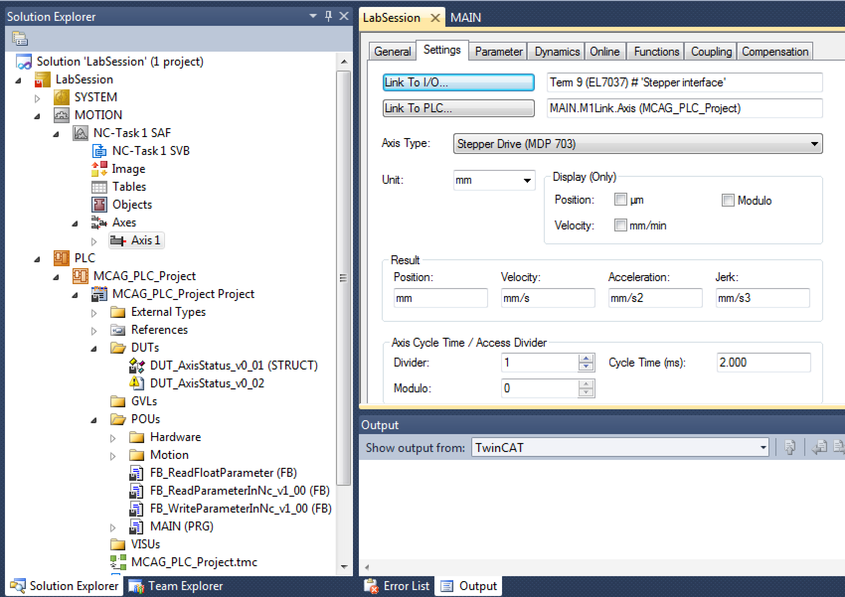
Motion Data Links
Link hardware to Axis
PLC
Link Axis to PLC
Motion
Hardware

Slide 19
Motion Control Loops
Current Control Loop:
Needed for both open and closed loop setups (however depends on actuator)
Functionality depends on motor type (phase shift output for commutation)
Current is related to torque via the motor K_{T} constant for rotary motors or to a force for linear motors.
Common sample rate range: 10-50kHz
Type: PI controller (maybe filters, observer)
Velocity Control Loop:
Needed for closed loop, sometimes used for open loop (frequency control)
Common sample rate range: 1-10kHz
Type: PI controller
Position Control Loop:
Needed for closed loop, sometimes used for open loop (for consistency)
Common sample rate range100-5kHz
Type: P or PI controller (if P the stationary error will be handled by velocity PI)

Slide 20
Motion Control Loops
Position Control
Speed Control
Current Control
O_{Position}
SP_{Speed} =FF_{Speed}
FF_{I}
+
+
+
+
+
+
SP_{Position}
P(ID)_{Position}
PI(D)_{Speed}
PI(D)_{I}
Process
-
-
PV_{Speed}
PV_{Position}
SP_{Position} Position setpoint
O_{Position} Position offset
PV_{Position} Actual position
SP_{Speed} Speed Setpoint
FF_{speed} Speed feed forward
PV_{Speed} Actual speed
Mech., motor, feedback

Slide 21
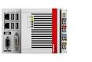
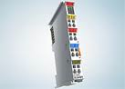
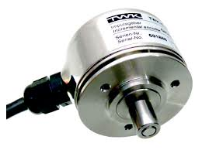
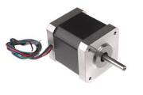
Control Loop Execution Options
CSP-Mode
Cyclic Sync. Position
CSV-Mode
Cyclic Sync. Velocity
CST-Mode
Cyclic Sync. Torque
- Trajectory gen.
- No control
-Trajectory gen.
-Position cont.
-Trajectory gen.
-Position cont.
-Velocity cont.
Act. position
Position setp.
Act. position
Velocity setp.
Act. position
Torque setp.
Amplifier
Level
Control:
Pos.
Velo.
Torque
Control:
Velo.
Torque
Control:
Torque
Controller: No loops needed
Drive: All control loops
Controller: Position loop
Drive: Velocity and current loop
Controller: Position, velocity loop
Drive: Current loop
Notes:
Also position interface.. Where traj is made in card! Good for open loop..

Slide 22
One more alternative…
Positioning Interface
- No control
Useful for open loop
stepper or for use when encoder is connected to local terminal.
Act. position
Position target position.
Amplifier
Level
Control:
Trajectory gen.
Pos.
Velo.
Torque
Controller: No loops needed
Drive: All control loops and trajectory generator
Notes:
Also position interface.. Where traj is made in card! Good for open loop..
No need for axis

Slide 23
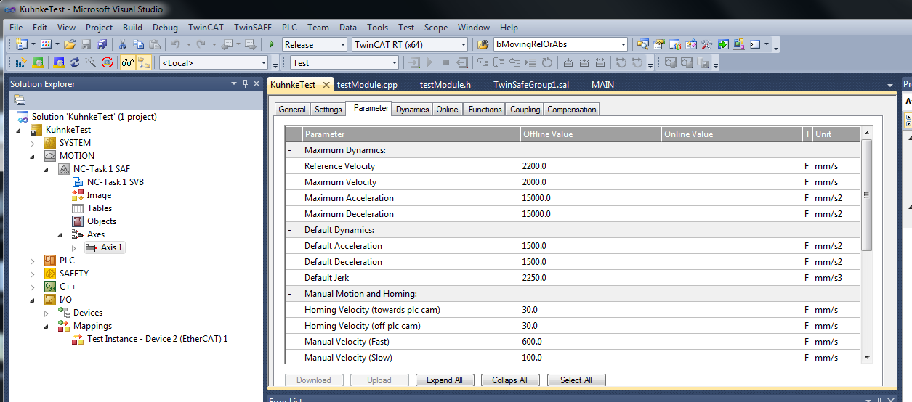
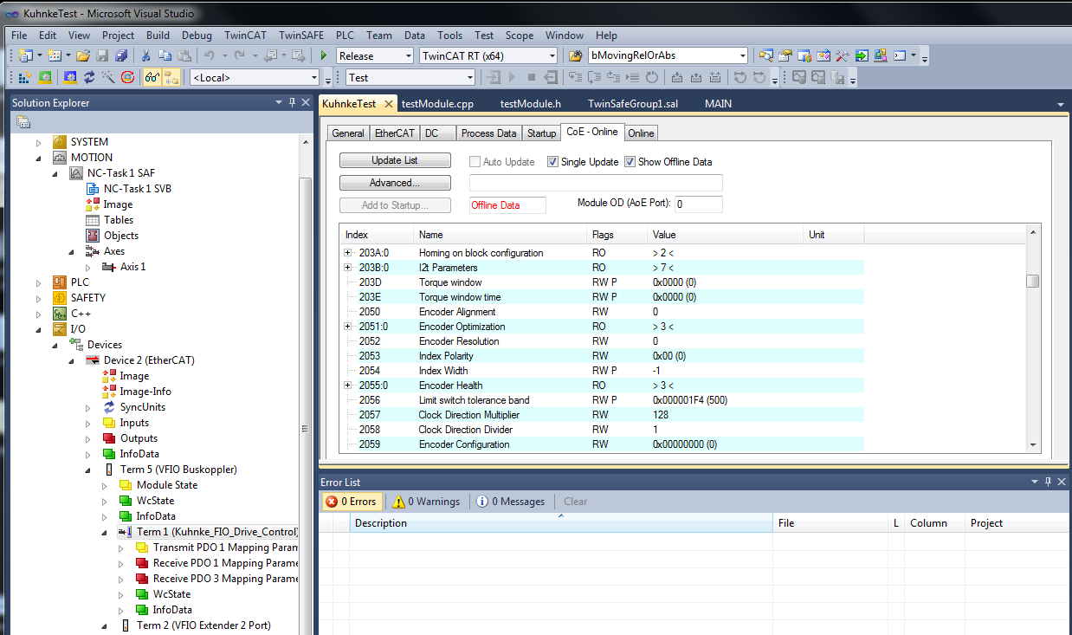
Configuration
Motion settings are made in Solution Explorer under “Motion” and in the actual I/O terminal.
Notes:
When running BLDC many settings are automatic. Steppers need some settings

Slide 24
Important Configurations
I/O card (important parameters start at CoE 0x8000):
Maximum current
Motor Voltage
Steps/rev
(Encoder resolution)
(Controller parameters)
(Modes)
Motion Axis (Settings for Controller):
Scale factors
Dynamics (acceleration, deceleration, jerk)
Velocities (max, manual, referencing)
Control parameter(s)
Notes:
When running BLDC many settings are automatic. Steppers need some settings

Slide 25
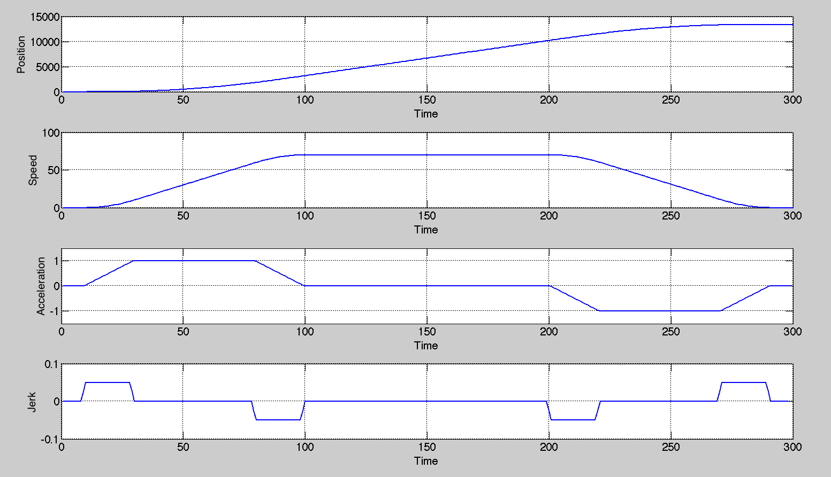
Feed Forward and Trajectory
Already known changes can be fed forward. The error for the controller to handle will be less. Scaling of velocity feed forward is made through the “Reference speed” parameter in the TwinCAT motion axis.
P(ID)_{Position}
+
PI(D)_{Speed}
+
PI(D)_{I (torque)}
Process

Slide 26
Feed Forward
Target position
Already known changes can be fed forward to increase performance.
➔The error for the controller to handle will be smaller.
Actual position
Trajectory generator set-point
Position Controller output
Feed Forward output (to speed PID)
No Feed Forward
Feed Forward
Feed Forward handles
main part of the control
Position / Output
Position / Output
Position controller
only handles small
deviations
Time
26
Time

Slide 27
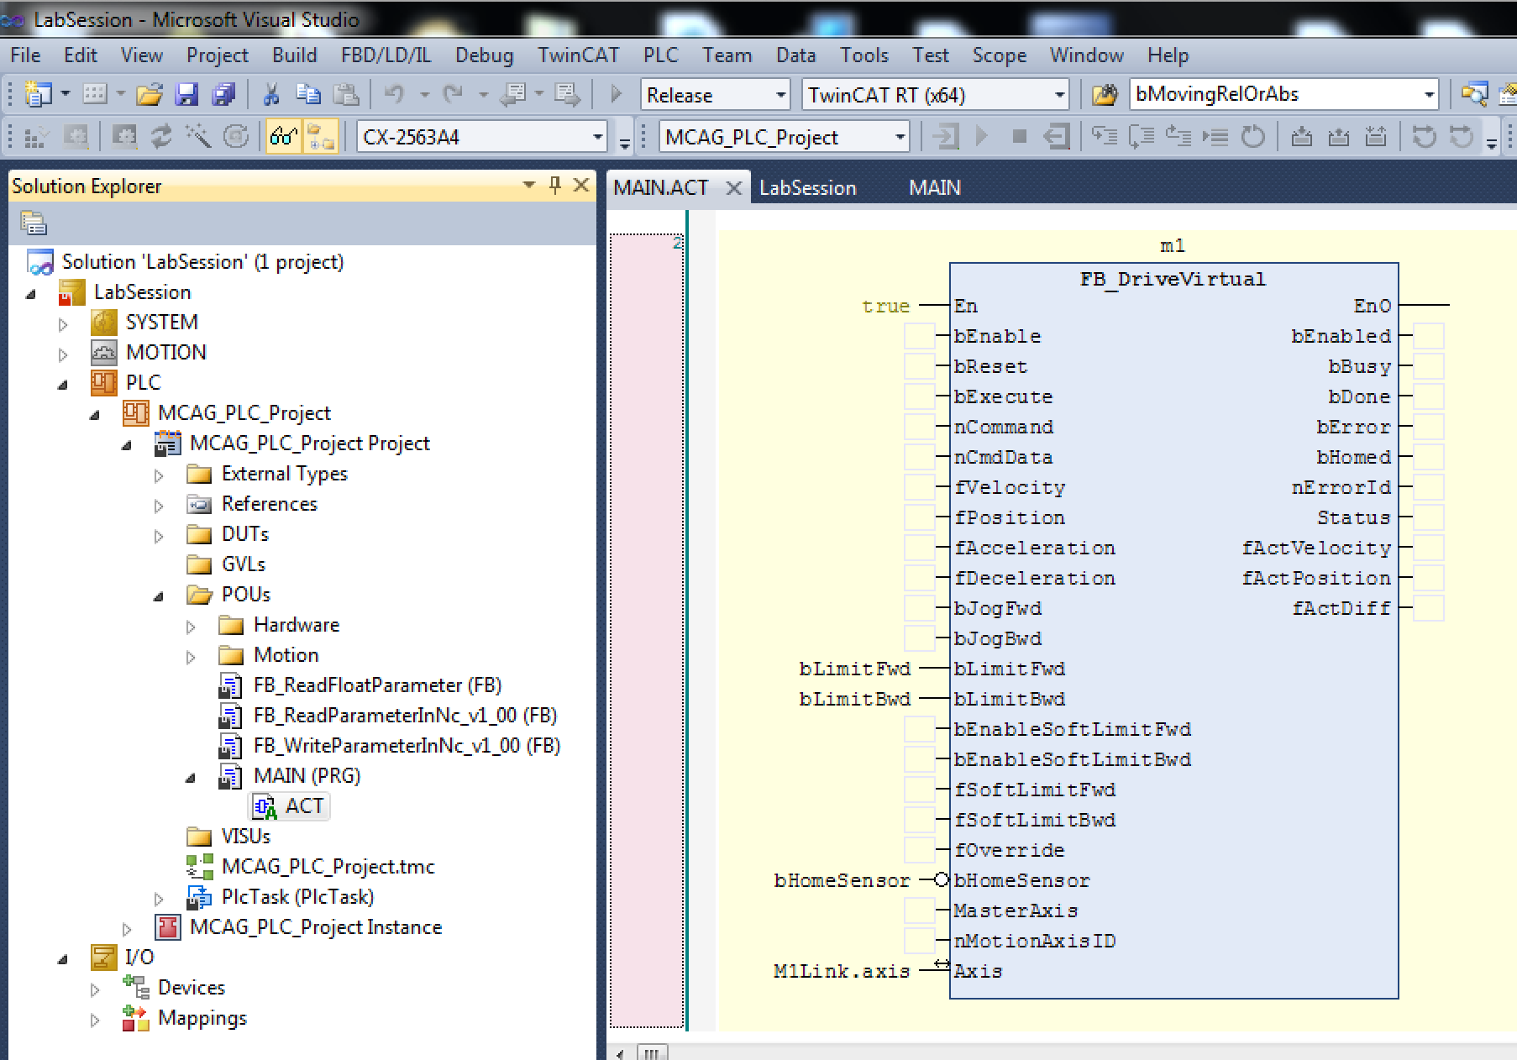
FB_DriveVirtual
Function block that handles most common use cases:
Absolute Positioning
Relative Positioning
Constant Velocity
Homing/Referencing Procedures
Jog
Implements EPCIS motor record functionalities

Slide 28
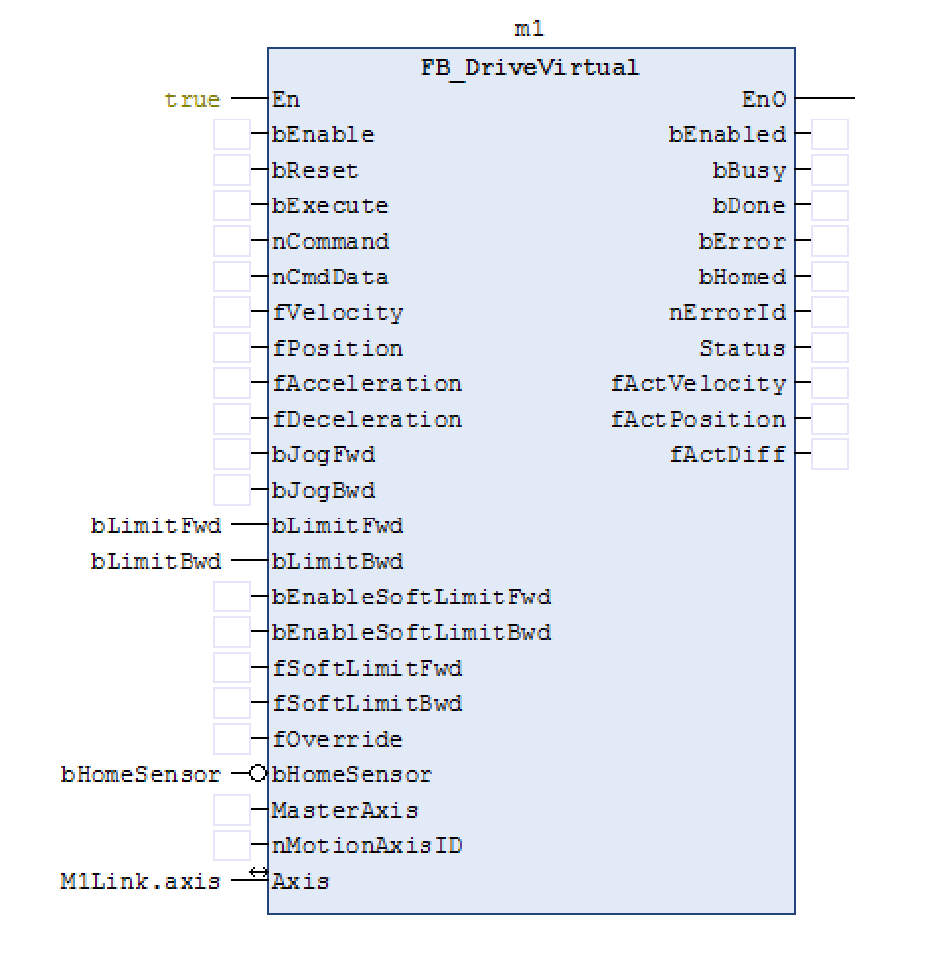
FB_DriveVirtual Operation
bEnable: Amplifier On/Off
nCommand: Defines commands
0 = Jog
1 = Constant Velocity
2 = Relative Positioning
3 = Absolute Positioning
10 = Homing/Referencing procedures
nCmdData: Parameter to nCommand
Example: For nCommand = 10, the nCmdData specifies which procedure to use.
fPosition: Target position
fVelocity: Target velocity
bExecute (Execute new command on rising edge)

Slide 29
FB_DriveVirtual Example
Absolute positioning to a target position of 100 with a target velocity of 200.
bEnable = 1 (Amplifier On)
nCommand = 3 (Absolute Positioning)
nCmdData = 0 (not used for nCommand =3)
fPosition = 100
fVelocity =200
bExecute = 0
bExecute = 1 (Positive Edge)
Note: EPICS motor record model 3 driver is utilizing FB_DriveVirtual in the same way.
Notes:
This is also how the motor record driver runs motion

Slide 30
Hands on Session
www.europeanspallationsource.se
14 November 2016

Slide 31
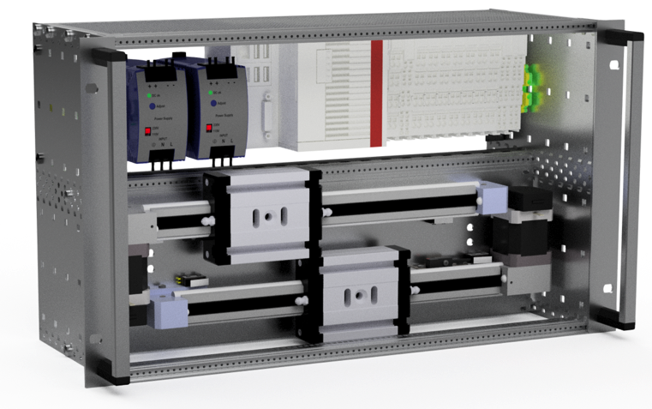
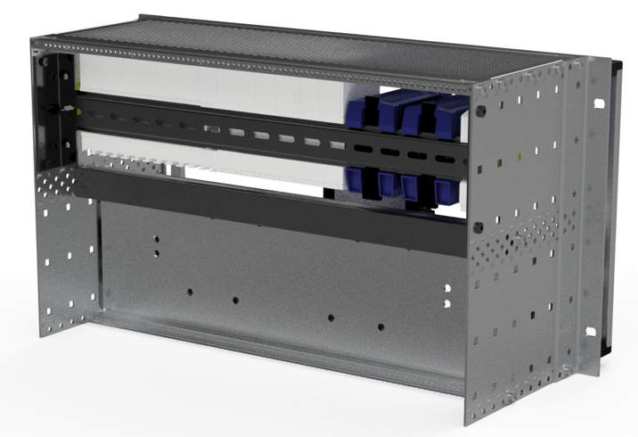
Hardware: Test Crates
19’’- 6HU – subcrate, depth 175mm
Different configurations for 1 or 2 axes
Standardized set of IOs per axis
Mechanics included
For both OS versions (W7/TwinCAT and Linux/Open Source)

Slide 32
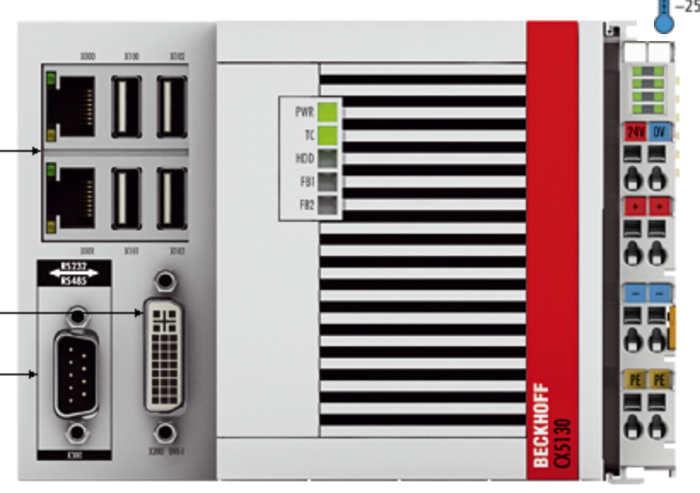
Hardware: CX5130 CPU
Embedded PC with Intel® Atom™ processor, 1.75 GHz, 2 cores (TC3: 40)
Flash memory slot for CFast card
Integrated 1-second UPS (1 MB persistent memory on CFast card)
Windows Embedded Standard 7 64 bit
3 network ports (2 RJ45 and 1 dedicated EtherCAT)
4 USB ports
DVI connection
Diagnostic LEDs (TwinCAT)
TwinCAT 3.1 Runtime installed
Licences (not all crates)

Slide 33
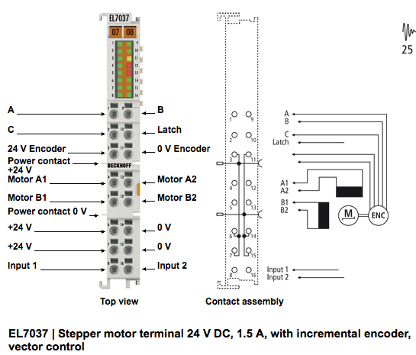
Hardware: EL7037 Drive Card
2 phase stepper drive
24V, 1.5A
Incremental Encoder (TTL)
2 Inputs
Distributed clock
Modes:
Open Loop (step counter)
Closed Loop with encoder
Vector Control (closed loop with current control)
Supported Control Modes:
Cyclic Synchronous Position
Cyclic Synchronous Velocity
Positioning Interface

Slide 34
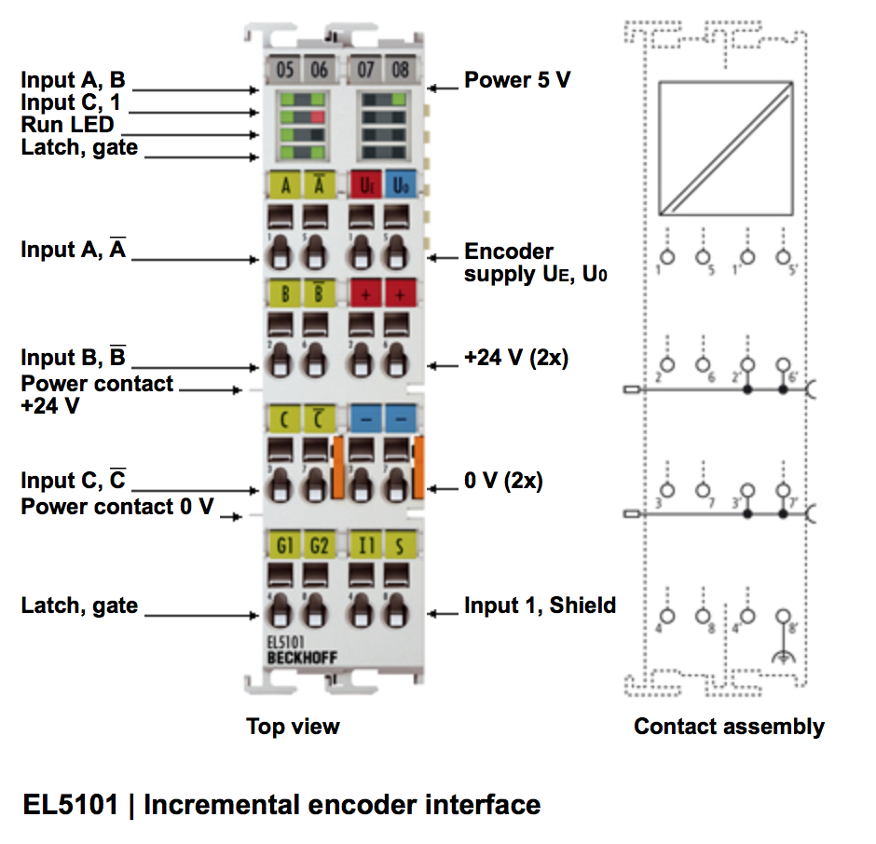
Hardware: EL5101 Incremental Encoder
Differential Incremental Encoder Interface (A, A/, B, B/, C, C/)
1 Input
Distributed clock
Latch, Gate functionalities (can be used as inputs)

Slide 35
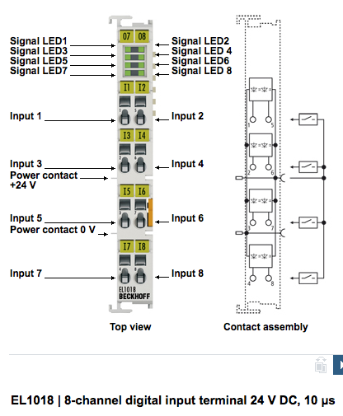
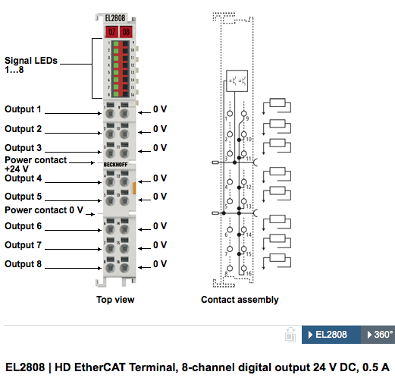
Hardware: EL1018, EL2808 Digital Inputs
EL1018:
8 inputs
24V
10 micro seconds filter
EL2808:
8 Outputs
24V, 0.5A

Slide 36
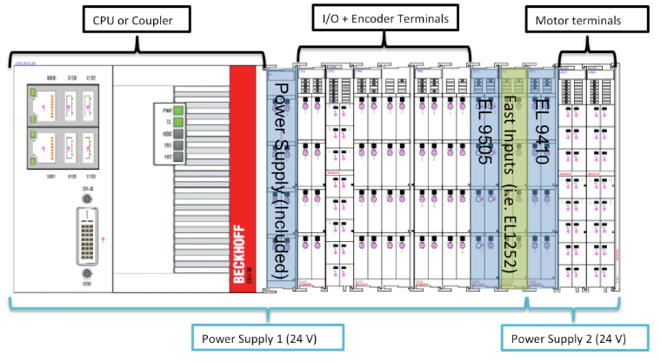
Power Concept

Slide 37
Tasks
Get familiar with hardware
Signal testing
Commission one axis in open loop
Commission one axis in closed loop
Test debug HMI (visualization FB_DriveViz..)
More detailed instructions will be available in the lab.
GOOD LUCK!

